Slide 1
Python Functions – Part 3
COP 4020
University of Central Florida

Slide 2
Before Functions, Indexing and Slicing
Simple indexing:
>>> mystring = "Hello World"
>>> mystring[0]
'H'
>>> mystring[5]
' ‘
>>> mystring[-2]
'l'

Slide 3
Now Slicing
>>> mystring = "abcdefghijk"
>>> mystring[2:]
'cdefghijk‘
>>> mystring[2:5]
'cde‘
>>> mystring[:3]
'abc'

Slide 4
More Slicing – adding step size
>>> mystring[::]
'abcdefghijk'
>>> mystring[::2]
'acegik‘
>>> mystring[::-1]
'kjihgfedcba‘

Slide 5
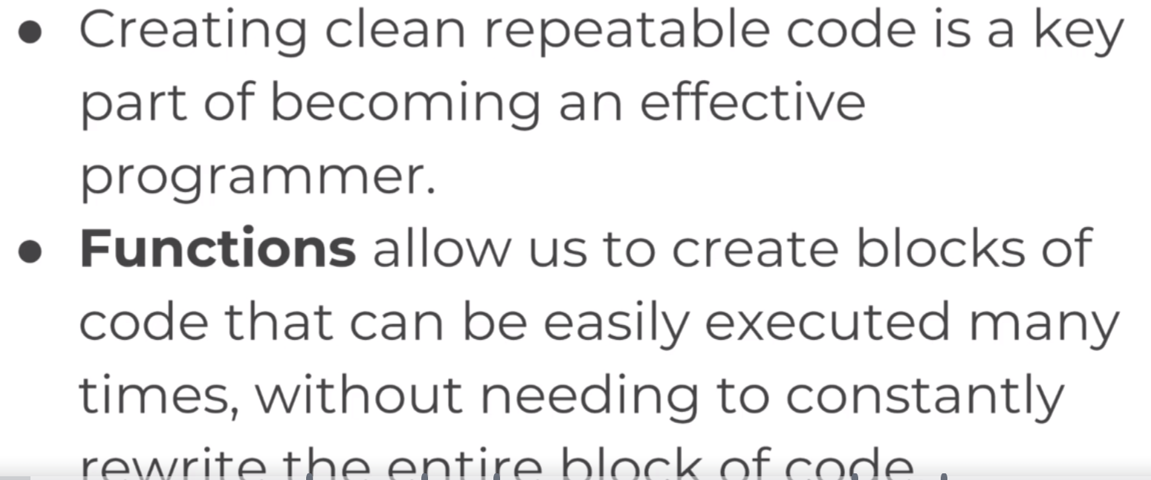

Slide 6
Function Syntax
>>> def name_of_function():
print("Hello World!!!")
>>> name_of_function()
Hello World!!!
>>>

Slide 7
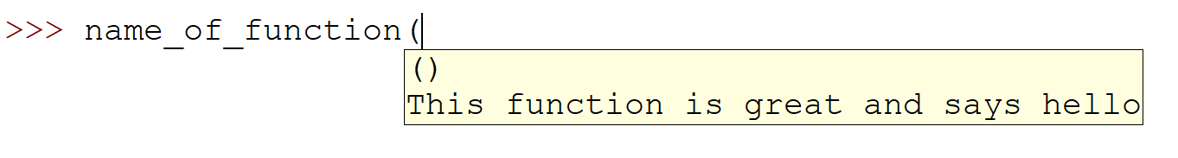
Doc Strings
It may be helpful to add function doc strings
>>> def name_of_function():
''' This function is great and says hello '''
print("Hello COP 4020 World!")

Slide 8
Parameters
>>> def name_of_function(name):
''' Takes a name parameter and says hello '''
print("Hello " + name + ", nice to have you here.")
>>> name_of_function("Rick")
Hello Rick, nice to have you here.

Slide 9
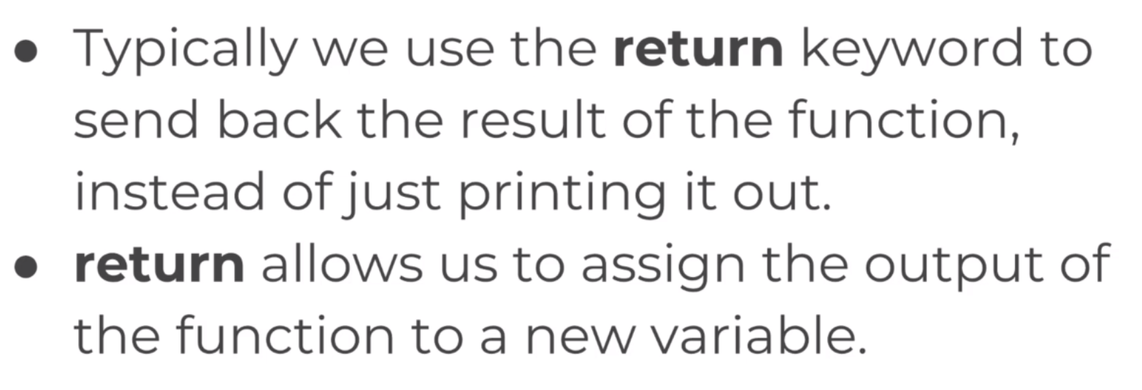
Returns

Slide 10
Returning
>>> def add_two_numbers(first,second):
return first+second
>>> add_two_numbers(3,5)
8
>>> newvar = add_two_numbers(4,12)
>>> newvar
16

Slide 11
Default Variable Values
>>> def say_hello(name='Sam Hill'):
print("Hello " + name )
>>> say_hello()
Hello Sam Hill
>>>
>>> say_hello("Rick")
Hello Rick

Slide 12
Simple Functions
>>> def dog_check( s ):
if 'dog' in s:
return True
else:
return False
>>> dog_check('this is a sentence with word dog in it')
True

Slide 13
Slightly Better
>>> def dog_check( s ):
if 'dog' in s.lower():
return True
else:
return False

Slide 14
Even Better
>>> def dog_check( s ):
return 'dog' in s.lower()
>>> dog_check('My dog ran away')
True
>>> dog_check('my cat ran away')
False

Slide 15
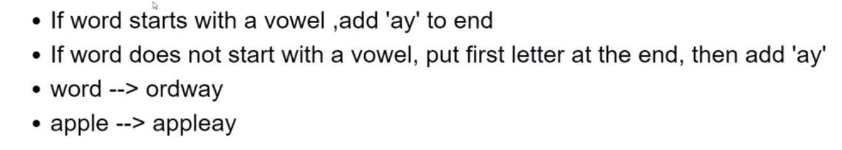
Pig Latin

Slide 16
Pig Latin Function
>>> def pig_latin(word):
first_letter = word[0]
# check if vowel
if first_letter in 'aeoiu':
pig_word = word + "ay"
else:
pig_word = word[1:] + first_letter + "ay"
return pig_word
>>> result = pig_latin('elephant')
>>> result
'elephantay'
>>> result = pig_latin('firetruck')
>>> result
'iretruckfay'

Slide 17
*args and *kwargs
Simple example to get started.
>>> def myfunc(a,b):
#returns 5% of sum of a and b
return sum((a,b)) * 0.05
>>> myfunc(5,6)
0.55

Slide 18
More Numbers?
What if we have more numbers than two, possibly an unknown quantity of numbers.
Possible solution:
>>> def myfunc(a,b,c=0):
#returns 5% of sum of a and b
return sum((a,b,c)) * 0.05
>>> myfunc(40,60)
5.0
def myfunc(a,b,c=0,d=0,e=0,f=0):
#returns 5% of sum of a and b
return sum((a,b,c,d,e,f)) * 0.05

Slide 19
Better Solution
>>> def myfunc(*args):
return sum(args)
>>> myfunc(2,3,4,5)
14

Slide 20
Iterating
>>> def myfunc2(*args):
for value in args:
print( value )
>>> myfunc2( 2,3,4,5,6,22,33,44,55)
2
3
4
5
6
22
33
44
55

Slide 21
Using **kwargs
**kwargs is like a dictionary.
>>> def myfunc3(**kwargs):
if 'fruit' in kwargs:
print("My fruit of choice is {}".format(kwargs['fruit']))
else:
print("I did not find any fruit")
>>> myfunc3(fruit='apple')
My fruit of choice is apple

Slide 22
Kwargs prints out as a dictionary
>>> def myfunc3(**kwargs):
print( kwargs)
if 'fruit' in kwargs:
print("My fruit of choice is {}".format(kwargs['fruit']))
else:
print("I did not find any fruit")
>>> myfunc3(fruit='apple',car='versa')
{'fruit': 'apple', 'car': 'versa'}
My fruit of choice is apple

Slide 23
Combining *args and **kwargs
>>> def myfunc4(*args, **kwargs):
print("I would like {} {}".format(args[0],kwargs['food']))
>>> myfunc4(10,20,30,fruit='orange',food='hamburger')
I would like 10 hamburger
NOTE:
>>> myfunc4(10,20,fruit='apple',30,food='cheeseburger')
SyntaxError: positional argument follows keyword argument

Slide 24
Lambdas, Map, and Filter
>>> def square(num):
return num*num
>>> square(15)
225
>>> mynums=[1,2,3,4,5]
>>> map(square,mynums)
<map object at 0x040EBF70>
>>> for item in map(square,mynums):
print( item )
1
4
9
16
25
>>> newlist = list(map(square,mynums))
>>> newlist
[1, 4, 9, 16, 25]

Slide 25
More Mapping
>>> def splicer(mystring):
if len(mystring) % 2 == 0:
return 'EVEN'
else:
return mystring[0]
>>> names = ['Andy','Eve','Sally']
>>> list(map(splicer,names))
['EVEN', 'E', 'S']

Slide 26
Using filter
>>> def check_even(num):
return num%2==0
>>> check_even(8)
True
>>> mynums =[1,2,3,4,5,6]
>>> filter(check_even,mynums)
<filter object at 0x040EBF70>
>>> list(filter(check_even,mynums))
[2, 4, 6]

Slide 27
Iterate Through Filter Result
>>> for item in filter(check_even,mynums):
print( item )
2
4
6

Slide 28
On To Lambdas
Start With:
>>> def square(num):
result = num ** 2
return result
Could be:
>>> def square(num):
return num ** 2

Slide 29
Lambdas
Could write last function:
>>> def square(num): return num ** 2
This is bad form, though, and should be avoided.
>>> lambda num: num ** 2
<function <lambda> at 0x0413D1E0>

Slide 30
Using a Lambda with map
>>> mylist = [1,2,3,4,5,6]
>>> list(map(lambda num: num ** 2, mylist))
[1, 4, 9, 16, 25, 36]

Slide 31
Using Lambda with filter
list(filter(lambda num:num%2==0,mynums))

Slide 32
More Mapping
>>> names = ['Sam','Joe','Sally']
>>> list(map(lambda name: name[0], names))
['S', 'J', 'S']

Slide 33
Nested Statements and Scopes
>> x = 25
>>> def printer():
x = 50
return x
>>> print(x)
25
>>> print(printer())
50
>>> print(x)
25

Slide 34
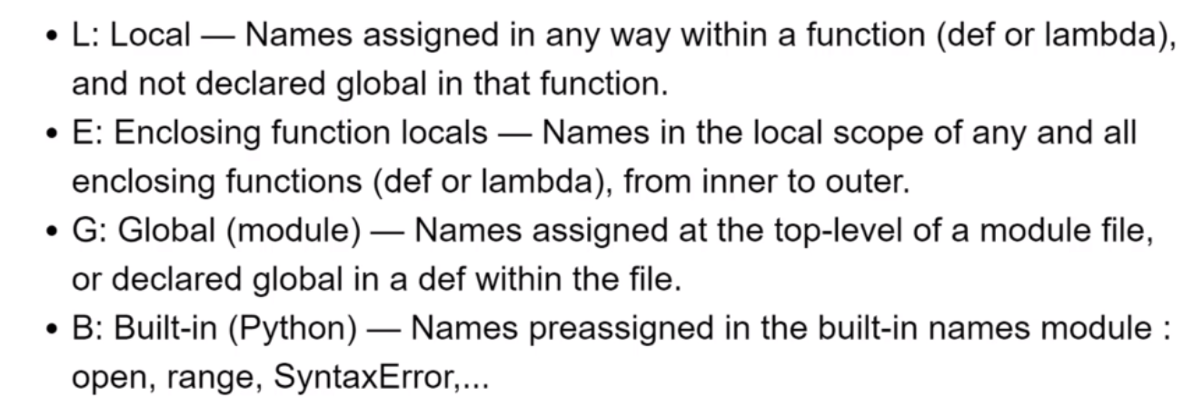
LEGB Rule

Slide 35
Local
lambda num: n ** 2
def printer():
x = 25
return x

Slide 36
More Code
>>> name = "THIS IS A GLOBAL STRING"
>>> def greet():
name = "Sammy"
def hello():
print("Hello " + name )
hello()
>>> greet()
Hello Sammy

Slide 37
Can Use Global
>>> def greet():
# name = "Sammy"
def hello():
print("Hello " + name )
hello()
>>> greet()
Hello THIS IS A GLOBAL STRING

Slide 38
Clarification
>>> #GLOBAL
>>> name = "THIS IS A GLOBAL STRING"
>>> def greet():
#ENCLOSING
name = "Sammy"
def hello():
#LOCAL
name = "LOCAL STRING"
print("Hello " + name )
hello()
>>> greet()
Hello LOCAL STRING

Slide 39
Accessing Global Variables
>>> x = 50
>>> def printer():
global x
x = 45
return x
>>> printer
<function printer at 0x0413DDB0>
>>> print("The printer function changed x to {}".format(printer()))
The printer function changed x to 45
>>> print(x)
45

Slide 40
Project Euler
If we list all the natural numbers below 10 that are multiples of 3 or 5, we get 3, 5, 6 and 9. The sum of these multiples is 23.
Find the sum of all the multiples of 3 or 5 below 1000.

Slide 41
Solution
def multiplesOf3And5( max ):
mylist = []
for i in range(1,max):
if i%3==0 or i%5==0:
mylist.append(i)
return sum(mylist)
print( multiplesOf3And5(10) )
print( multiplesOf3And5(1000) )

Slide 42
Alternate Solution
def multiplesOf3And5( max ):
runningTotal = 0
for i in range(1,max):
if i%3==0 or i%5==0:
runningTotal += i
return runningTotal
print( multiplesOf3And5(10) )
print( multiplesOf3And5(1000) )

Slide 43
Next Problem
Each new term in the Fibonacci sequence is generated by adding the previous two terms. By starting with 1, 1, and 2, the first 10 terms will be:
1, 1, 2, 3, 5, 8, 13, 21, 34, 55, ...
By considering the terms in the Fibonacci sequence whose values do not exceed four million, find the sum of the even-valued terms.

Slide 44
Create a fibList Function
def fibList( max ):
list = [1,1,2]
def nextFib( f, s, mx ):
if f + s >= mx:
return
else:
list.append( f + s )
nextFib( s, f+s, mx )
nextFib(1,2,max)
return list

Slide 45
Limit to Even Numbers
mylist = list(filter( lambda num: num%2==0, fibList( 4000000 )))
print( mylist )
print( sum(mylist) )

Slide 46
The prime factors of 13195 are 5, 7, 13 and 29.
What is the largest prime factor of the number 600851475143 ?

Slide 47
Start with isPrime Function
import math
def isPrime( num ):
sqr = int(math.sqrt(num))
for i in range(2,sqr+1):
if num%i==0:
return False
return True
for i in range( 1,100):
print("{} {}".format(i,isPrime(i)))

Slide 48
Now Create isFactor function
def isFactor( possibleFactor, largerNumber ):
return largerNumber%possibleFactor==0

Slide 49
Iterate Through For Loop Searching for Prime Factors
def largestPrimeFactor( num ):
mylist = []
for i in range( 2, int(num/2)):
if isFactor( i, num ) and isPrime( i ):
mylist.append( i )
return max(mylist)

Slide 50
Test
print(largestPrimeFactor( 13195 ))
print(largestPrimeFactor( 600851475143 ))

Slide 51
Another
A palindromic number reads the same both ways. The largest palindrome made from the product of two 2-digit numbers is 9009 = 91 × 99.
Find the largest palindrome made from the product of two 3-digit numbers.

Slide 52
Create isPalindrome Function
def isPalindrome( num ):
first = str(num)
second = first[::-1]
return first == second

Slide 53
Create Palindrome List from x to y
def palindromeList( start, end ):
mylist = []
for i in range(start,end+1):
for j in range(start,end+1):
if i == j:
continue
if isPalindrome( i * j ):
mylist.append( i * j )
return mylist

Slide 54
Wrap Up
print( max( palindromeList( 10, 99 ) ) )
9009
print( max( palindromeList( 100, 999 ) ) )
906609

Slide 55
Smallest Multiple
2520 is the smallest number that can be divided by each of the numbers from 1 to 10 without any remainder.
What is the smallest positive number that is evenly divisible by all of the numbers from 1 to 20?

Slide 56
Start by Reusing isFactor
def isFactor( possibleFactor, largerNumber ):
return largerNumber%possibleFactor==0

Slide 57
Create Function isDivisibleBy x to y for num
def isDivisibleBy( start, end, num ):
for i in range(start,end+1):
if not isFactor( i, num ):
return False
return True

Slide 58
Now Find Smallest Multiple
def findSmallestMultiple():
num = 20
while( not isDivisibleBy( 1, 20, num ) ):
num += 1
return num

Slide 59
Sum/Square Difference
The sum of the squares of the first ten natural numbers is,
1² + 2² + ... + 10² = 385
The square of the sum of the first ten natural numbers is,
(1 + 2 + ... + 10)² = 55² = 3025
Hence the difference between the sum of the squares of the first ten natural numbers and the square of the sum is 3025 − 385 = 2640.
Find the difference between the sum of the squares of the first one hundred natural numbers and the square of the sum.

Slide 60
Create SumOfSquares Function
def sumOfSquares( maxNumber ):
mylist = []
for i in range(1,maxNumber+1):
mylist.append(i**2)
return sum(mylist)

Slide 61
Create SquareOfSums Function
def squareOfSums( maxNumber ):
mylist = []
for i in range(1,maxNumber+1):
mylist.append(i)
return sum(mylist)**2

Slide 62
Tying Them Together
def diff( maxNumber ):
return squareOfSums( maxNumber ) - sumOfSquares( maxNumber )

